Slide 1
Advanced deep-learning best practices
Dr. Noman Islam

Slide 2
Lecture Outline
Using the Keras functional API, you can build graph-like models, share a layer across different inputs, and use Keras models just like Python functions.
Keras callbacks and the TensorBoard browser-based visualization tool let you monitor models during training.
We’ll also discuss several other best practices including batch normalization, residual connections, hyperparameter optimization, and model ensembling.

Slide 3
Sequential API
The Sequential model makes the assumption that the network has exactly one input and exactly one output, and that it consists of a linear stack of layers
But this set of assumptions is too inflexible in a number of cases.
Some networks require several independent inputs, others require multiple outputs, and some networks have internal branching between layers that makes them look like graphs of layers rather than linear stacks of layers.

Slide 4
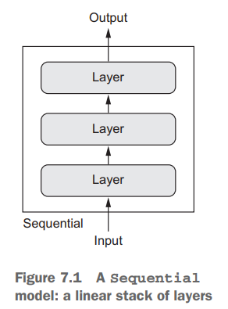

Slide 5
Multimodal inputs
Some tasks, for instance, require multimodal inputs: they merge data coming from different input sources, processing each type of data using different kinds of neural layers
Imagine a deep-learning model trying to predict the most likely market price of a second-hand piece of clothing, using the following inputs: user-provided metadata (such as the item’s brand, age, and so on), a user-provided text description, and a picture of the item.

Slide 6
If you had only the metadata available, you could one-hot encode it and use a densely connected network to predict the price.
If you had only the text description available, you could use an RNN or a 1D convnet.
If you had only the picture, you could use a 2D convnet. But how can you use all three at the same time?

Slide 7
A naive approach would be to train three separate models and then do a weighted average of their predictions.
But this may be suboptimal
A better way is to jointly learn a more accurate model of the data by using a model that can see all available input modalities simultaneously: a model with three input branches

Slide 8
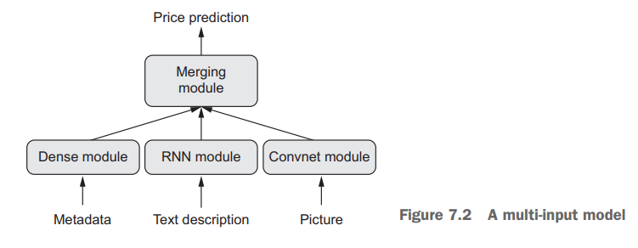

Slide 9
Multi-modal outputs
Given the text of a novel or short story, you might want to automatically classify it by genre (such as romance or thriller) but also predict the approximate date it was written.
Of course, you could train two separate models: one for the genre and one for the date.
But because these attributes aren’t statistically independent, you could build a better model by learning to jointly predict both genre and date at the same time.

Slide 10
Such a joint model would then have two outputs, or heads.
Due to correlations between genre and date, knowing the date of a novel would help the model learn rich, accurate representations of the space of novel genres, and vice versa.

Slide 11
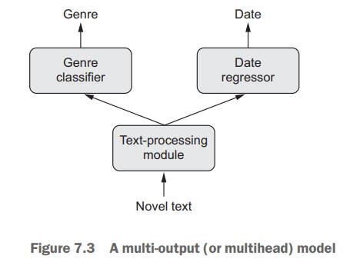

Slide 12
Non-linear network architectures
Additionally, many recently developed neural architectures require nonlinear network topology: networks structured as directed acyclic graphs.
The Inception family of networks (developed by Szegedy et al. at Google), for instance, relies on Inception modules, where the input is processed by several parallel convolutional branches whose outputs are then merged back into a single tensor.

Slide 13
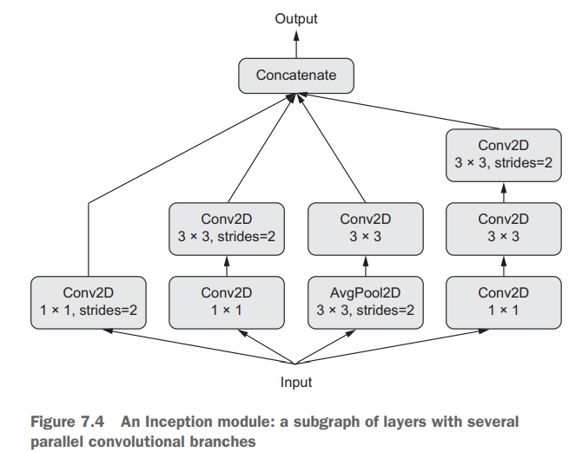

Slide 14
Residual Connections
There’s also the recent trend of adding residual connections to a model, which started with the ResNet family of networks (developed by He et al. at Microsoft).
A residual connection consists of reinjecting previous representations into the downstream flow of data by adding a past output tensor to a later output tensor, which helps prevent information loss along the data-processing flow.
There are many other examples of such graph-like networks.

Slide 15
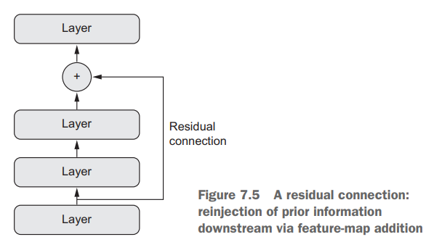

Slide 16
The need for functional API
These three important use cases—multi-input models, multi-output models, and graph-like models—aren’t possible when using only the Sequential model class in Keras.
But there’s another far more general and flexible way to use Keras: the functional API

Slide 17


Functional API
In the functional API, you directly manipulate tensors, and you use layers as functions that take tensors and return tensors (hence, the name functional API):

Slide 18
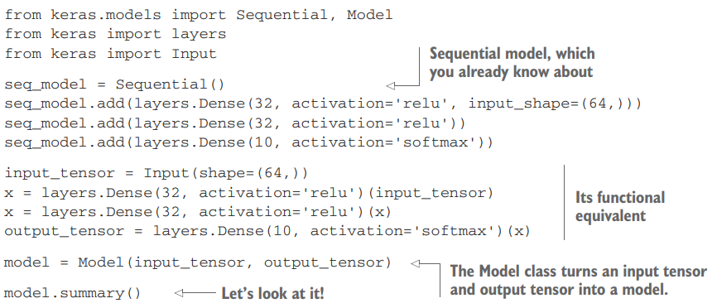
A side-by-side example

Slide 19
The only part that may seem a bit magical at this point is instantiating a Model object using only an input tensor and an output tensor.
Behind the scenes, Keras retrieves every layer involved in going from input_tensor to output_tensor, bringing them together into a graph-like data structure—a Model.
Of course, the reason it works is that output_tensor was obtained by repeatedly transforming input_tensor. If you tried to build a model from inputs and outputs that weren’t related, you’d get a RuntimeError

Slide 20
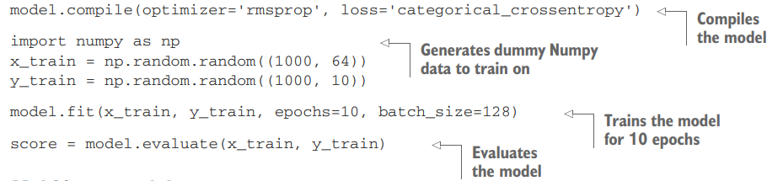
When it comes to compiling, training, or evaluating such an instance of Model, the API is the same as that of Sequential:

Slide 21
Multi-input models
A typical question-answering model has two inputs: a natural-language question and a text snippet (such as a news article) providing information to be used for answering the question.
The model must then produce an answer: in the simplest possible setup, this is a one-word answer obtained via a softmax over some predefined vocabulary

Slide 22
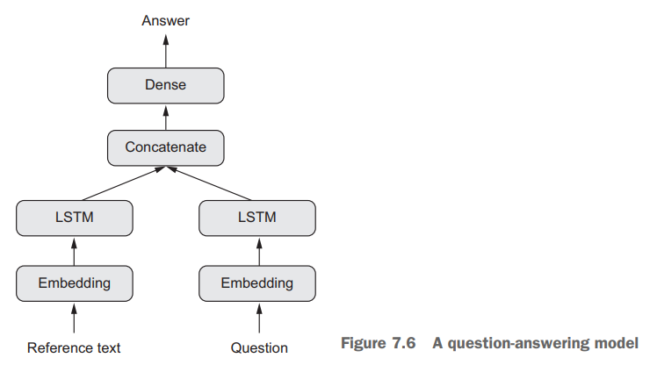

Slide 23
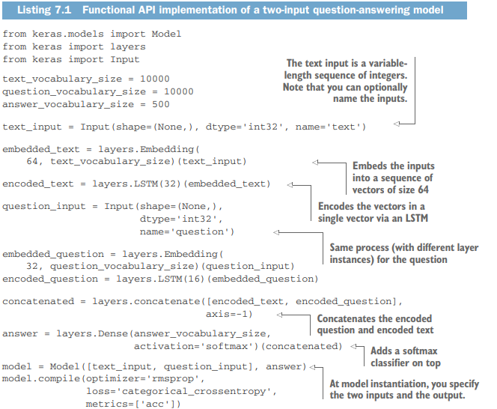

Slide 24
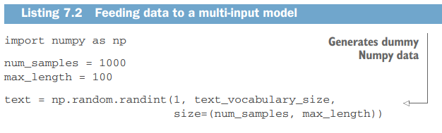
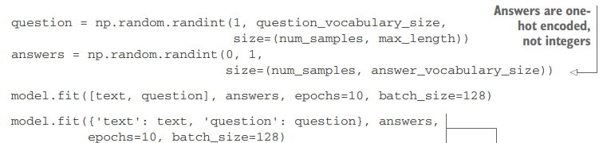

Slide 25
Multi-output models
A simple example is a network that attempts to simultaneously predict different properties of the data, such as a network that takes as input a series of social media posts from a single anonymous person and tries to predict attributes of that person, such as age, gender, and income level

Slide 26
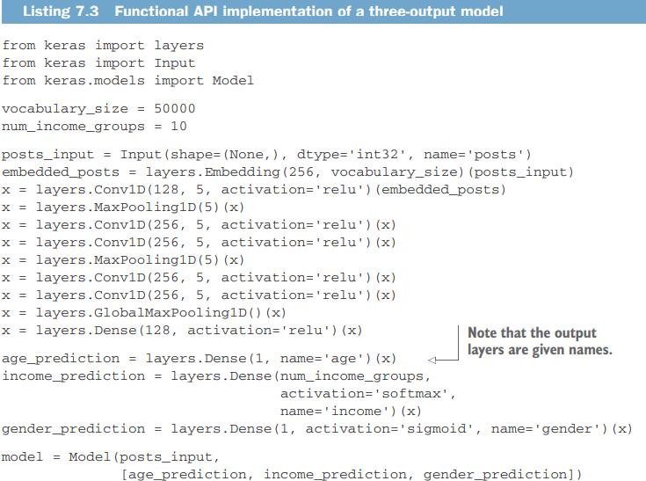

Slide 27
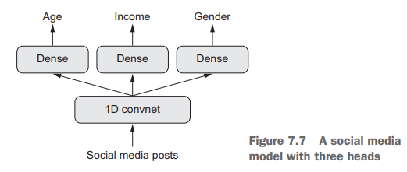

Slide 28
Specifying loss
Importantly, training such a model requires the ability to specify different loss functions for different heads of the network: for instance, age prediction is a scalar regression task, but gender prediction is a binary classification task, requiring a different training procedure.
But because gradient descent requires you to minimize a scalar, you must combine these losses into a single value in order to train the model.

Slide 29
The simplest way to combine different losses is to sum them all.
In Keras, you can use either a list or a dictionary of losses in compile to specify different objects for different outputs; the resulting loss values are summed into a global loss, which is minimized during training.

Slide 30
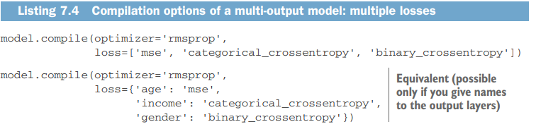

Slide 31
Balancing loss contributions
Note that very imbalanced loss contributions will cause the model representations to be optimized preferentially for the task with the largest individual loss, at the expense of the other tasks.
To remedy this, you can assign different levels of importance to the loss values in their contribution to the final loss.
This is useful in particular if the losses’ values use different scales.

Slide 32
For instance, the mean squared error (MSE) loss used for the age-regression task typically takes a value around 3–5, whereas the crossentropy loss used for the gender-classification task can be as low as 0.1.
In such a situation, to balance the contribution of the different losses, you can assign a weight of 10 to the crossentropy loss and a weight of 0.25 to the MSE loss.

Slide 33
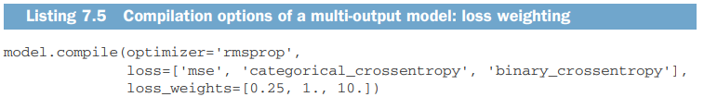
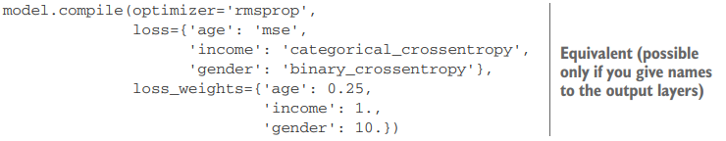

Slide 34
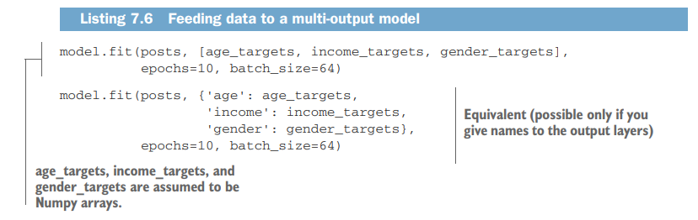

Slide 35
Directed acyclic graphs of layers
With the functional API, not only can you build models with multiple inputs and multiple outputs, but you can also implement networks with a complex internal topology.
Several common neural-network components are implemented as graphs.
Two notable ones are Inception modules and residual connections.

Slide 36
Inception module
It consists of a stack of modules that themselves look like small independent networks, split into several parallel branches.
The most basic form of an Inception module has three to four branches starting with a 1 × 1 convolution, followed by a 3 × 3 convolution, and ending with the concatenation of the resulting features.

Slide 37
This setup helps the network separately learn spatial features and channel-wise features, which is more efficient than learning them jointly.
More-complex versions of an Inception module are also possible, typically involving pooling operations, different spatial convolution sizes (for example, 5 × 5 instead of 3 × 3 on some branches), and branches without a spatial convolution (only a 1 × 1 convolution).

Slide 38
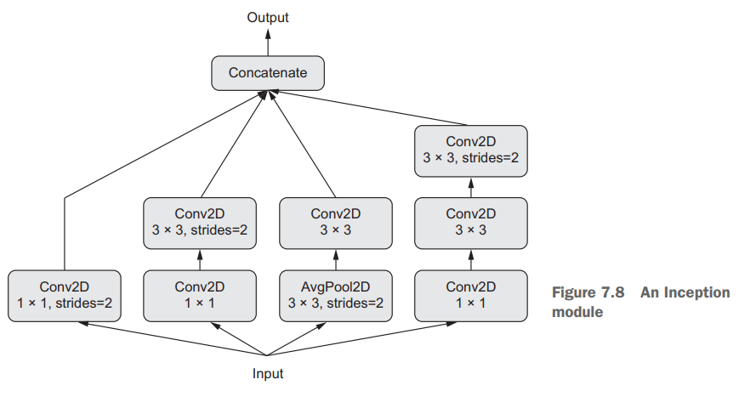

Slide 39
1X1 convolution
You already know that convolutions extract spatial patches around every tile in an input tensor and apply the same transformation to each patch.
An edge case is when the patches extracted consist of a single tile.
The convolution operation then becomes equivalent to running each tile vector through a Dense layer: it will compute features that mix together information from the channels of the input tensor, but it won’t mix information across space (because it’s looking at one tile at a time).

Slide 40
Such 1 × 1 convolutions (also called pointwise convolutions) are featured in Inception modules, where they contribute to factoring out channel-wise feature learning and spacewise feature learning—a reasonable thing to do if you assume that each channel is highly autocorrelated across space, but different channels may not be highly correlated with each other.

Slide 41
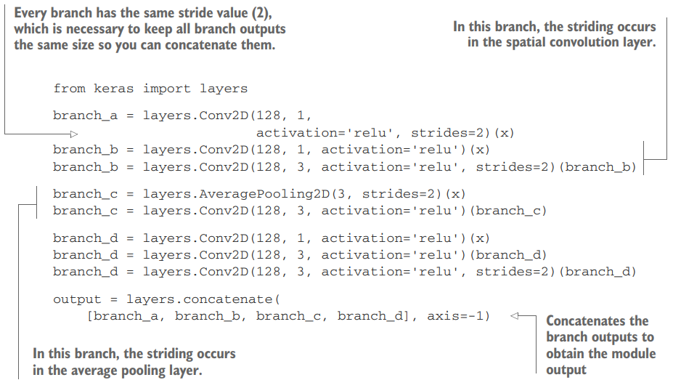

Slide 42
Xception
Xception, which stands for extreme inception, is a convnet architecture loosely inspired by Inception.
It takes the idea of separating the learning of channel-wise and space-wise features to its logical extreme, and replaces Inception modules with depthwise separable convolutions consisting of a depthwise convolution (a spatial convolution where every input channel is handled separately) followed by a pointwise convolution (a 1 × 1 convolution)—effectively, an extreme form of an Inception module, where spatial features and channel-wise features are fully separated.

Slide 43
Xception has roughly the same number of parameters as Inception V3, but it shows better runtime performance and higher accuracy on ImageNet as well as other large-scale datasets, due to a more efficient use of model parameters.

Slide 44
Residual connections
They tackle two common problems that plague any large-scale deep-learning model: vanishing gradients and representational bottlenecks.
In general, adding residual connections to any model that has more than 10 layers is likely to be beneficial.
A residual connection consists of making the output of an earlier layer available as input to a later layer, effectively creating a shortcut in a sequential network. Rather than being concatenated to the later activation, the earlier output is summed with the later activation, which assumes that both activations are the same size.
If they’re different sizes, you can use a linear transformation to reshape the earlier activation into the target shape

Slide 45
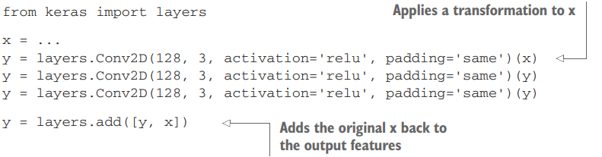

Slide 46
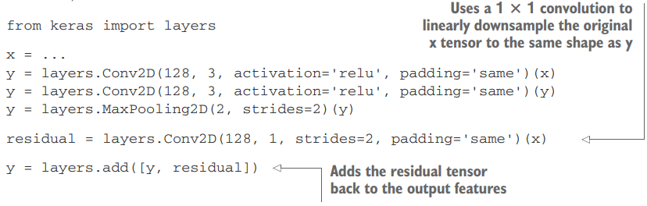

Slide 47
Layer weight sharing
One more important feature of the functional API is the ability to reuse a layer instance several times. When you call a layer instance twice, instead of instantiating a new layer for each call, you reuse the same weights with every call.
This allows you to build models that have shared branches—several branches that all share the same knowledge and perform the same operations.
That is, they share the same representations and learn these representations simultaneously for different sets of inputs.

Slide 48
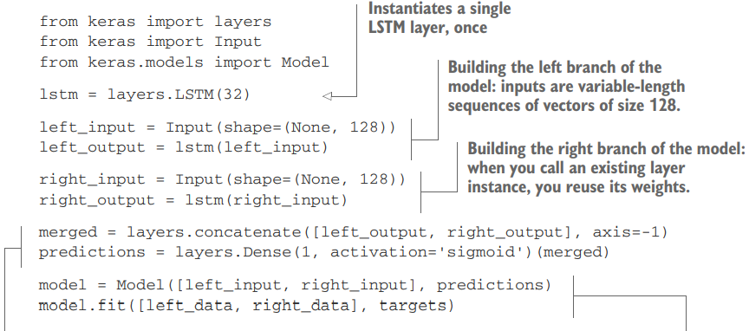

Slide 49
Models as layers
Importantly, in the functional API, models can be used as you’d use layers—effectively, you can think of a model as a “bigger layer.”
This is true of both the Sequential and Model classes. This means you can call a model on an input tensor and retrieve an output tensor:
y = model(x)

Slide 50
If the model has multiple input tensors and multiple output tensors, it should be called with a list of tensors:
y1, y2 = model([x1, x2])
When you call a model instance, you’re reusing the weights of the model—exactly like what happens when you call a layer instance.
Calling an instance, whether it’s a layer instance or a model instance, will always reuse the existing learned representations of the instance—which is intuitive.

Slide 51
One simple practical example of what you can build by reusing a model instance is a vision model that uses a dual camera as its input: two parallel cameras, a few centimeters (one inch) apart.
Such a model can perceive depth, which can be useful in many applications. You shouldn’t need two independent models to extract visual features from the left camera and the right camera before merging the two feeds.
Such low-level processing can be shared across the two inputs: that is, done via layers that use the same weights and thus share the same representations.

Slide 52
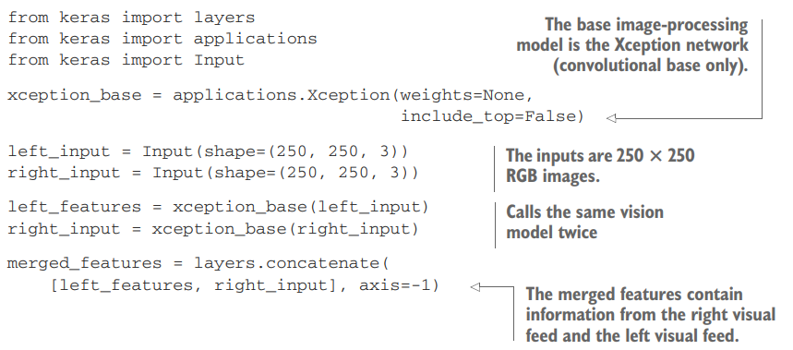

Slide 53
Inspecting and monitoring deep-learning models using Keras callbacks and TensorBoard
In this section, we’ll review ways to gain greater access to and control over what goes on inside your model during training.
Launching a training run on a large dataset for tens of epochs using model.fit() or model.fit_generator() can be a bit like launching a paper airplane: past the initial impulse, you don’t have any control over its trajectory or its landing spot.

Slide 54
If you want to avoid bad outcomes (and thus wasted paper airplanes), it’s smarter to use not a paper plane, but a drone that can sense its environment, send data back to its operator, and automatically make steering decisions based on its current state.
The techniques we present here will transform the call to model.fit() from a paper airplane into a smart, autonomous drone that can selfintrospect and dynamically take action

Slide 55
Using callbacks to act on a model during training
When you’re training a model, there are many things you can’t predict from the start.
In particular, you can’t tell how many epochs will be needed to get to an optimal validation loss.
A much better way to handle this is to stop training when you measure that the validation loss in no longer improving.

Slide 56
This can be achieved using a Keras callback. A callback is an object (a class instance implementing specific methods) that is passed to the model in the call to fit and that is called by the model at various points during training.
It has access to all the available data about the state of the model and its performance, and it can take action: interrupt training, save a model, load a different weight set, or otherwise alter the state of the model.

Slide 57
Model checkpointing—Saving the current weights of the model at different points during training.
Early stopping—Interrupting training when the validation loss is no longer improving (and of course, saving the best model obtained during training).
Dynamically adjusting the value of certain parameters during training—Such as the learning rate of the optimizer.
Logging training and validation metrics during training, or visualizing the representations learned by the model as they’re updated—The Keras progress bar that you’re familiar with is a callback!

Slide 58
The keras.callbacks module includes a number of built-in callbacks (this is not an exhaustive list):
keras.callbacks.ModelCheckpoint
keras.callbacks.EarlyStopping
keras.callbacks.LearningRateScheduler
keras.callbacks.ReduceLROnPlateau
keras.callbacks.CSVLogger

Slide 59
The Model Chceckpoint and Early Stopping Callbacks
You can use the EarlyStopping callback to interrupt training once a target metric being monitored has stopped improving for a fixed number of epochs.
For instance, this callback allows you to interrupt training as soon as you start overfitting, thus avoiding having to retrain your model for a smaller number of epochs.

Slide 60
This callback is typically used in combination with ModelCheckpoint, which lets you continually save the model during training (and, optionally, save only the current best model so far: the version of the model that achieved the best performance at the end of an epoch):

Slide 61
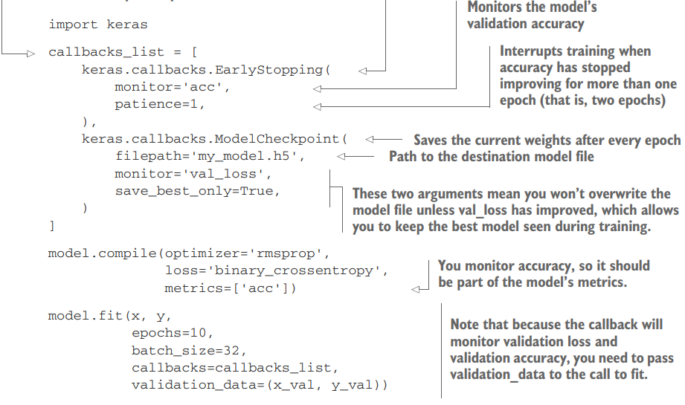

Slide 62
The Reduce LR on Plateau CallBack
You can use this callback to reduce the learning rate when the validation loss has stopped improving.
Reducing or increasing the learning rate in case of a loss plateau is an effective strategy to get out of local minima during training.

Slide 63
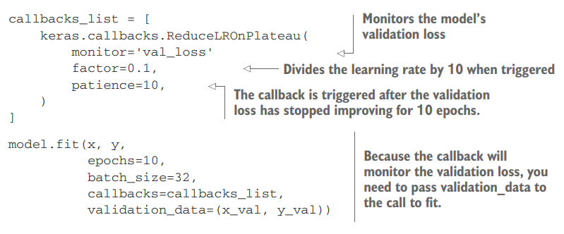

Slide 64
Writing your own callback
If you need to take a specific action during training that isn’t covered by one of the built-in callbacks, you can write your own callback.
Callbacks are implemented by subclassing the class keras.callbacks.Callback.
You can then implement any number of the following transparently named methods, which are called at various points during training:
on_epoch_begin
on_epoch_end
on_batch_begin
on_batch_end
on_train_begin
on_train_end

Slide 65
These methods all are called with a logs argument, which is a dictionary containing information about the previous batch, epoch, or training run: training and validation metrics, and so on.
Additionally, the callback has access to the following attributes:
self.model—The model instance from which the callback is being called
self.validation_data—The value of what was passed to fit as validation data

Slide 66
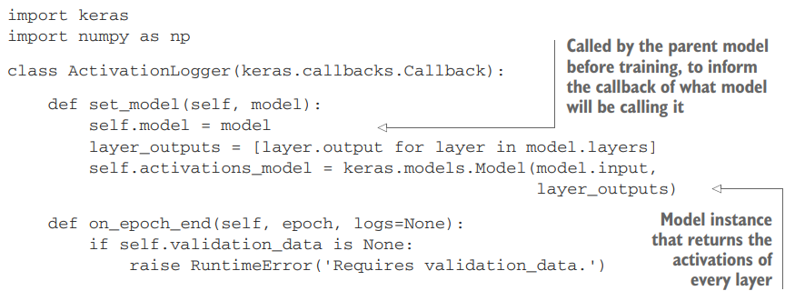
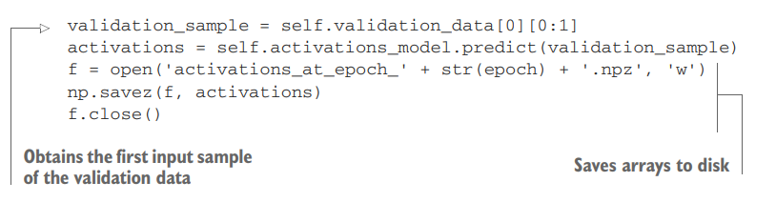

Slide 67
Introduction to TensorBoard
To do good research or develop good models, you need rich, frequent feedback about what’s going on inside your models during your experiments.
TensorBoard, a browser-based visualization tool that comes packaged with TensorFlow.
The key purpose of TensorBoard is to help you visually monitor everything that goes on inside your model during training.
If you’re monitoring more information than just the model’s final loss, you can develop a clearer vision of what the model does and doesn’t do, and you can make progress more quickly

Slide 68
Features of Tensorboard
Visually monitoring metrics during training
Visualizing your model architecture
Visualizing histograms of activations and gradients
Exploring embeddings in 3D

Slide 69
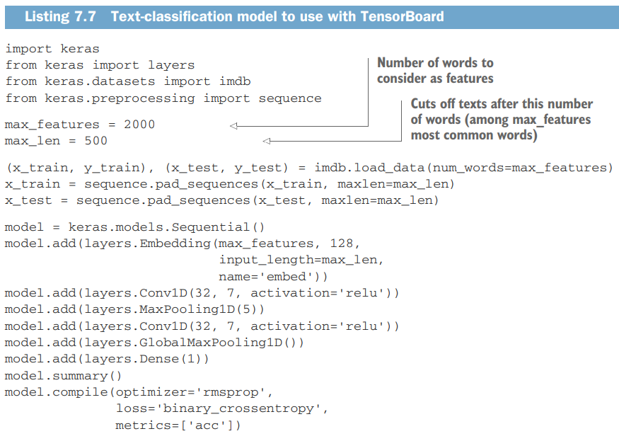

Slide 70
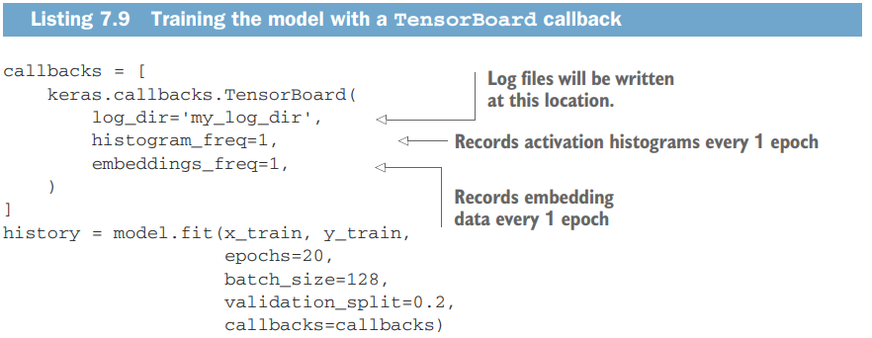

Slide 71
At this point, you can launch the TensorBoard server from the command line, instructing it to read the logs the callback is currently writing.
The tensorboard utility should have been automatically installed on your machine the moment you installed TensorFlow (for example, via pip):
$ tensorboard --logdir=my_log_dir

Slide 72
You can then browse to http://localhost:6006 and look at your model training
In addition to live graphs of the training and validation metrics, you get access to the Histograms tab, where you can find pretty visualizations of histograms of activation values taken by your layers

Slide 73
The Embeddings tab gives you a way to inspect the embedding locations and spatial relationships of the 10,000 words in the input vocabulary, as learned by the initial Embedding layer.
Because the embedding space is 128-dimensional, TensorBoard automatically reduces it to 2D or 3D using a dimensionality-reduction algorithm of your choice: either principal component analysis (PCA) or t-distributed stochastic neighbor embedding (t-SNE).

Slide 74
Batch Normalization
Previous examples normalized data before feeding it into models.
But data normalization should be a concern after every transformation operated by the network: even if the data entering a Dense or Conv2D network has a 0 mean and unit variance, there’s no reason to expect a priori that this will be the case for the data coming out.

Slide 75
Batch normalization is a type of layer (BatchNormalization in Keras) introduced in 2015 by Ioffe and Szegedy; it can adaptively normalize data even as the mean and variance change over time during training.
It works by internally maintaining an exponential moving average of the batch-wise mean and variance of the data seen during training.

Slide 76
The main effect of batch normalization is that it helps with gradient propagation—much like residual connections—and thus allows for deeper networks.
Some very deep networks can only be trained if they include multiple BatchNormalization layers.
For instance, BatchNormalization is used liberally in many of the advanced convnet architectures that come packaged with Keras, such as ResNet50, Inception V3, and Xception.

Slide 77
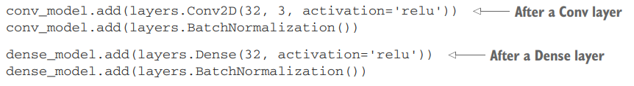

Slide 78
Batch renormalization
A recent improvement over regular batch normalization is batch renormalization, introduced by Ioffe in 2017
It offers clears benefits over batch normalization, at no apparent cost.
Even more recently, Klambauer et al. introduced self-normalizing neural networks, b which manage to keep data normalized after going through any Dense layer by using a specific activation function (selu) and a specific initializer (lecun_normal).

Slide 79
This scheme, although highly interesting, is limited to densely connected networks for now, and its usefulness hasn’t yet been broadly replicated

Slide 80
Depthwise Separable Convolution
There’s a layer you can use as a drop-in replacement for Conv2D that will make your model lighter (fewer trainable weight parameters) and faster (fewer floating-point operations) and cause it to perform a few percentage points better on its task?
That is precisely what the depthwise separable convolution layer does (SeparableConv2D)
This layer performs a spatial convolution on each channel of its input, independently, before mixing output channels via a pointwise convolution (a 1 × 1 convolution)

Slide 81
This is equivalent to separating the learning of spatial features and the learning of channel-wise features, which makes a lot of sense if you assume that spatial locations in the input are highly correlated, but different channels are fairly independent.
It requires significantly fewer parameters and involves fewer computations, thus resulting in smaller, speedier models.
And because it’s a more representationally efficient way to perform convolution, it tends to learn better representations using less data, resulting in better-performing models.

Slide 82
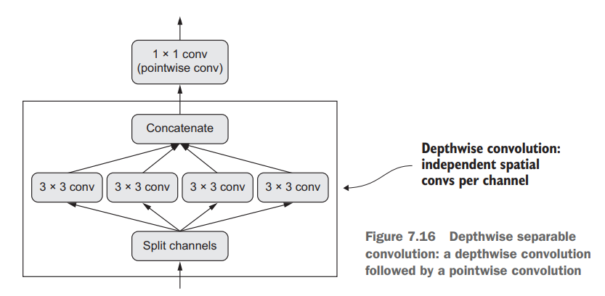

Slide 83
These advantages become especially important when you’re training small models from scratch on limited data.
For instance, here’s how you can build a lightweight, depthwise separable convnet for an image-classification task (softmax categorical classification) on a small dataset:

Slide 84
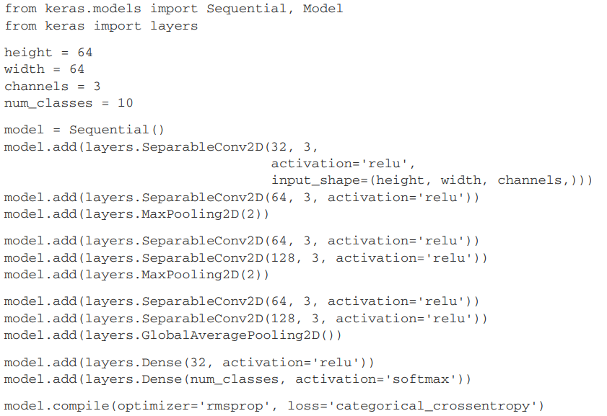

Slide 85
Hyperparameter optimization
When building a deep-learning model, you have to make many seemingly arbitrary decisions: How many layers should you stack? How many units or filters should go in each layer? Should you use relu as activation, or a different function? Should you use BatchNormalization after a given layer? How much dropout should you use? And so on.
These architecture-level parameters are called hyperparameters to distinguish them from the parameters of a model, which are trained via backpropagation.

Slide 86
In practice, experienced machine-learning engineers and researchers build intuition over time as to what works and what doesn’t when it comes to these choices— they develop hyperparameter-tuning skills.

Slide 87
Process of optimizing hyperparameters
Choose a set of hyperparameters (automatically).
Build the corresponding model.
Fit it to your training data, and measure the final performance on the validation data.
Choose the next set of hyperparameters to try (automatically).
Repeat.
Eventually, measure performance on your test data.

Slide 88
Because these challenges are difficult and the field is still young, we currently only have access to very limited tools to optimize models.
Often, it turns out that random search (choosing hyperparameters to evaluate at random, repeatedly) is the best solution, despite being the most naive one.

Slide 89
But one tool I have found reliably better than random search is Hyperopt (https://github.com/hyperopt/hyperopt), a Python library for hyperparameter optimization that internally uses trees of Parzen estimators to predict sets of hyperparameters that are likely to work well.
Another library called Hyperas (https://github.com/maxpumperla/hyperas) integrates Hyperopt for use with Keras models. Do check it out.

Slide 90
Model ensembling
Another powerful technique for obtaining the best possible results on a task is model ensembling.
Ensembling consists of pooling together the predictions of a set of different models, to produce better predictions.
If you look at machine-learning competitions, in particular on Kaggle, you’ll see that the winners use very large ensembles of models that inevitably beat any single model, no matter how good.

Slide 91
Ensembling relies on the assumption that different good models trained independently are likely to be good for different reasons: each model looks at slightly different aspects of the data to make its predictions, getting part of the “truth” but not all of it
The easiest way to pool the predictions of a set of classifiers (to ensemble the classifiers) is to average their predictions at inference time

Slide 92
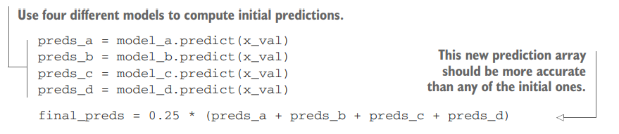

Slide 93
A smarter way to ensemble classifiers is to do a weighted average, where the weights are learned on the validation data—typically, the better classifiers are given a higher weight, and the worse classifiers are given a lower weight.
The key to making ensembling work is the diversity of the set of classifiers

